Slide 1
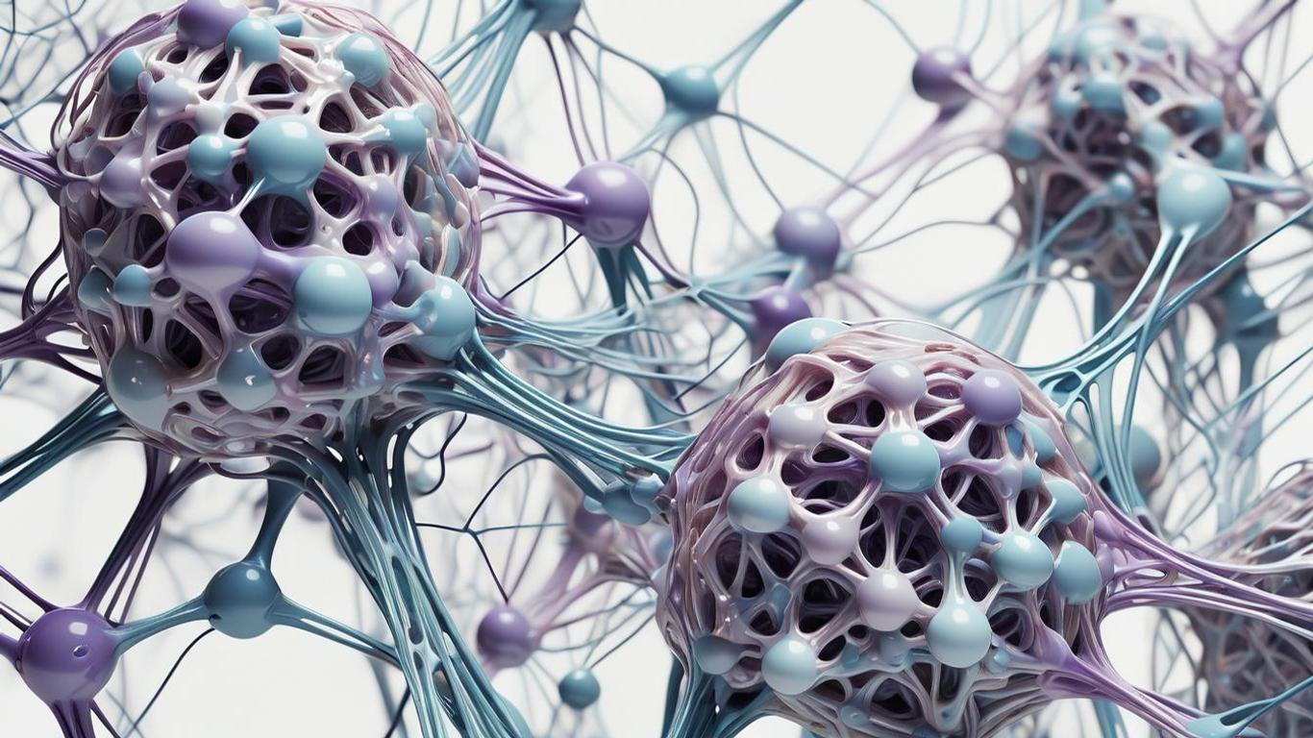
Fully automatic CNN design with inception and ResNet blocks
Tal Gaon Yovel Gabay

Slide 2
Presentation Outline
Brief overview of Convolutional Neural Networks (CNNs)
Challenges of Manual CNN Design
Concepts and explanations
Network structure
Experiment Design and Results
Conclusion

Slide 3
Introduction to the Article
This article propose a framework for the automatic construction of CNN architectures based on ResNet, DenseNet, and Inception blocks and the roulette wheel selection method (GA).
Simplify the process of designing CNN architectures
Reducing the need for manual intervention and expertise.

Slide 4
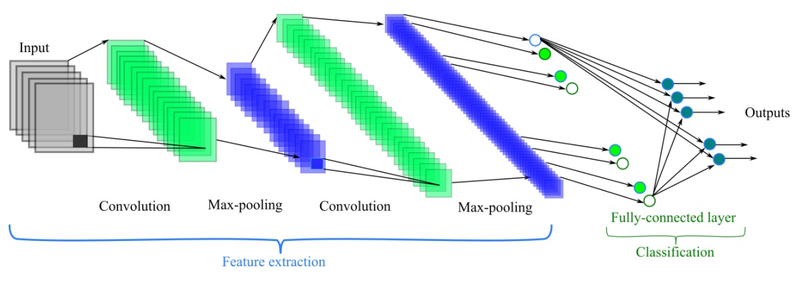
Convolutional Neural Networks (CNNs)
Excel in image recognition and classification.
Built with specialized layers:
Convolutional: Extract features like edges and textures.
Pooling: Reduce complexity and control overfitting.
Fully connected: Classify based on extracted features.

Slide 5
Hyperparameters in Convolutional Neural Networks (CNNs)
Common hyperparameters in CNNs include:
Learning rate: Step size in optimization, affects learning speed and quality.
Filter size: Determines the spatial range of convolutional layers, impacting feature extraction.
Number of layers: Depth and complexity of network architecture.
Batch size: Number of samples processed in each training iteration.
Activation function: Non-linearity of the model, affects capacity to learn complex patterns.

Slide 6
Challenges of Manual CNN Design
In the realm of Convolutional Neural Networks (CNNs), manual design poses significant challenges.
Manual CNN Design: Involves time-consuming trial-and-error for hyperparameters and architecture optimization.
Expertise Needed: Requires expertise in architecture design and specific problem domains, hindering accessibility.
Complexity with Depth: As CNN depth increases, manual design complexity grows, leading to potential errors.
Limited Generalization: Manually designed CNNs may not generalize well across domains, requiring redesigns.

Slide 7
Concepts and explanations Introduction to the solution

Slide 8
1 X 1 Convolution
Shrink the number of channels
*
X Relu
=
6 X6X16
1X1X16
6 X6X1
calculates the weighted sum of the input values at each spatial location (6x6 grid) across all 16 channels of the input feature map

Slide 9
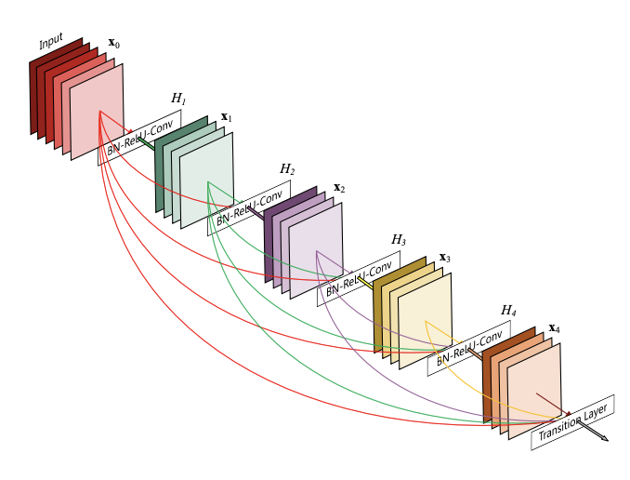
DenseNet blocks
Each layer receives concatenation of feature maps from all the previous layers.
Why DensNet?
Reduces vanishing-gradient problem: Gradients have multiple paths to flow backward through the network.
Reducing the number of parameters: the reuse of features learned by previous layers, the network reduces the need for unique parameters
Stronger feature propagation: The dense connections helps in preserving useful features extracted from the input data.

Slide 10
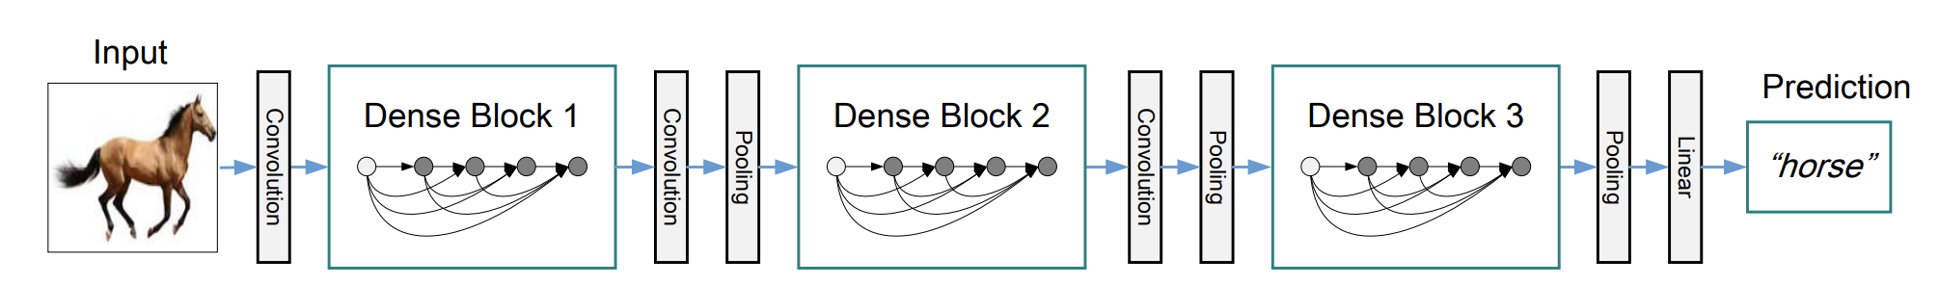
DenseNet
Transition layers : used to control the complexity of the model, change feature-map sizes
1 X 1 convolution layer
Max pooling layer

Slide 11
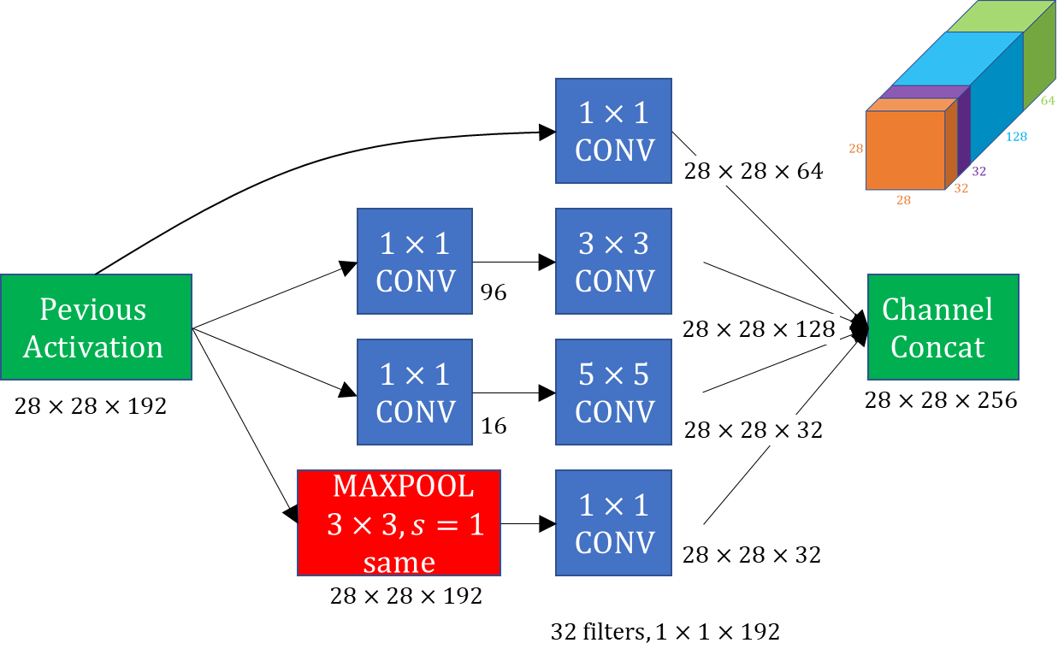

Inception blocks
To reduce the computational cost, makes the Inception block effective for feature extraction
The key idea of the Inception module is to use several filter sizes instead of only one, concatenate and pass them to the next layer
$$⇓$$
The features of the image at different spatial sizes are preserved
For example, smaller filters are effective at capturing little details, while larger filters can capture wider patterns.

Slide 12
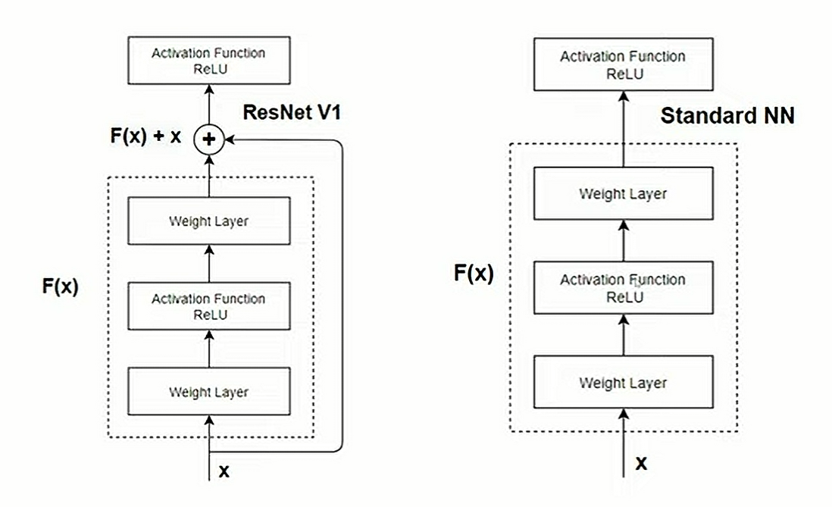
ResNet(Residual Network)
H(x))
In traditional neural networks, each layer aims to learn a direct mapping from input to output.
Instead of learning direct mappings (x to H(x)), ResNets learn residual mappings (F(x)).
Residual function (F(x)) represents the difference between input (x) and output (H(x)) of a layer or block.
Skip connections
directly adding input to output.
Vanishing gradient problem - even if the gradients approaching zero in the deeper layers, skip connections ensure that gradients can reach earlier layers more easily during backpropagation.
H(x)) =
residual mappings

Slide 13
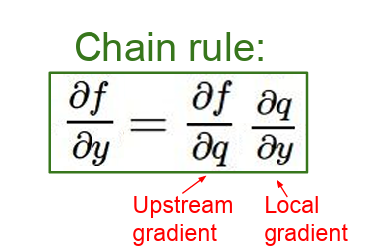
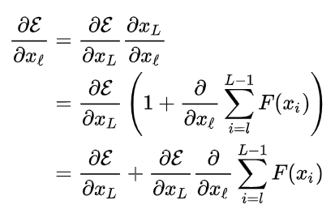

Forward propagation
If the output of the ℓ-th residual block is the input to the (ℓ+1)-th block the formulation is: ${ x}_{ℓ+1}= F(x_{ℓ}) +x_{ℓ}$
For ${ x}_{ℓ+2}$ : ${ x}_{ℓ+2}= F\left(x_{ℓ+1}\right)+F\left(x_{ℓ}\right)+ x_{ℓ}$
So for ${ x}_{L}: { x}_{L}=$ ${ x}_{ℓ} + \sum_{i=l}^{L−1}{F\left(x_{i}\right)}$
$L$is the index of any later residual block
Backward propagation here, $ε$ is a loss function to be minimized
Even if the gradients of the $F\left(x_{ℓ}\right)$ are small, the total gradient $\frac{∂ε}{∂x_{ℓ}}$ is not vanishing thanks to the added term $\frac{∂ε}{∂x_{L}}$
Notes:
be

Slide 14
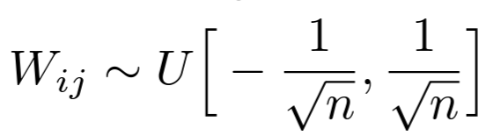
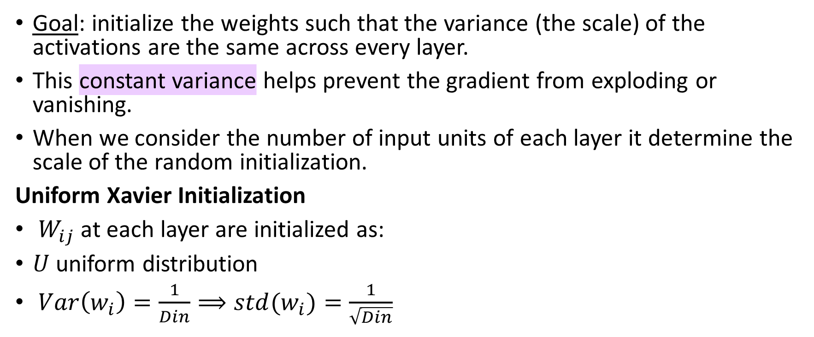
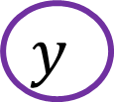
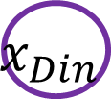
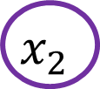
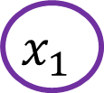
Xavier weights Initialization
Goal: initialize the weights such that the variance (the scale) of the activations are the same across every layer.
This constant variance helps prevent the gradient from exploding or vanishing.
When we consider the number of input units of each layer it determine the scale of the random initialization.
Uniform Xavier Initialization
$W_{ij}$ at each layer are initialized as:
$U$ uniform distribution
$Var\left(w_{i}\right)=\frac{1}{Din}⟹std(w_{i})=\frac{1}{\sqrt{Din}}$
$$x_{1}$$
$$x_{2}$$
$$y$$
$$x_{Din}$$

Slide 15
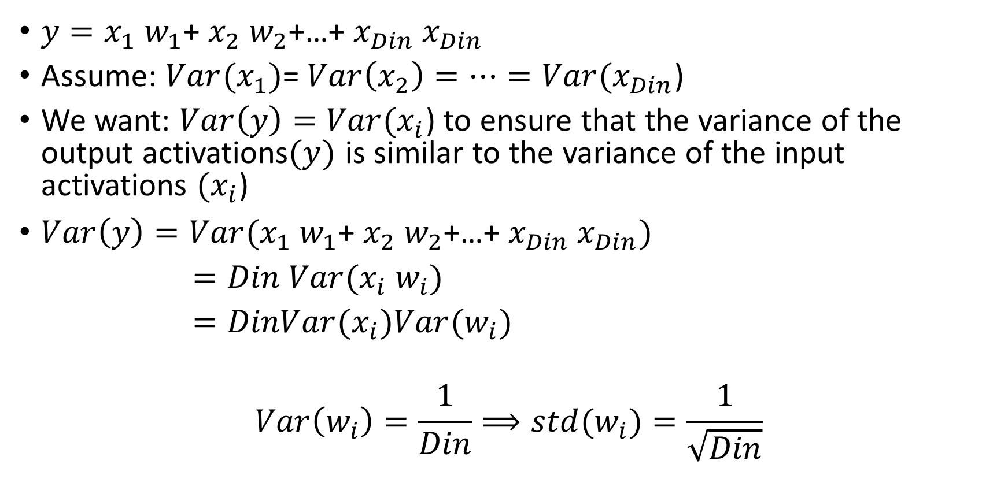




Xavier weights Initialization
$$x_{1}$$
$$x_{2}$$
$$y$$
$y=x_{1}$ $w_{1}$+ $x_{2}$ $w_{2}$+…+ $x_{Din}$ $x_{Din}$
Assume: $Var(x_{1})$= $Var\left(x_{2}\right)=…=Var(x_{Din}$)
We want: $Var\left(y\right)=$ $Var(x_{i}$) to ensure that the variance of the output activations$(y)$ is similar to the variance of the input activations $(x_{i}$)
$Var\left(y\right)=Var(x_{1} w_{1}\text{+ }x_{2} w_{2}\text{+}\text{…}\text{+ }x_{Din} x_{Din})$
$=Din Var(x_{i} w_{i})$
$=DinVar(x_{i})Var(w_{i})$
$$Var\left(w_{i}\right)=\frac{1}{Din}⟹std(w_{i})=\frac{1}{\sqrt{Din}}$$
$$x_{Din}$$
Notes:
Why Is Initialization Important?
For starters, an improper initialization would lead to an unoptimizable model.
Choosing the right initializer is an essential step in training to maximize performance.
In addition, initializing weighted neural networks also shortens the convergence time and minimizes the loss function

Slide 16
Introduction to Evolutionary Algorithms
Evolutionary Algorithms or Genetic Algorithms (GAs) are optimization techniques inspired by the process of natural selection and genetics, including selection, reproduction, mutation, and crossover.
1st
generation
Parent #1
Parent #2
Parent #3
1 | 1 | 1 | 0 | 0
0 | 0 | 0 | 1 | 1
1 | 0 | 1 | 0 | 1
0 | 1 | 0 | 1 | 0
0 | 1 | 0 | 1 | 1
1 | 1 | 1 | 1 | 1
... #N
Fitness score:8.1
Fitness score:3.5
Fitness score:5.9
crossover
Offspring #1
Offspring #2
2nd generation
(before mutate)
1 | 1 | 1 | 0 | 0
1 | 1 | 1 | 1 | 1
0 | 1 | 0 | 1 | 1
0 | 0 | 0 | 1 | 1
... #N
mutation
2nd generation
(after mutate)
Offspring #1
Offspring #2
1 | 1 | 1 | 0 | 0
1 | 1 | 1 | 1 | 1
0 | 1 | 0 | 0 | 1
0 | 0 | 0 | 1 | 1
... #N
Fitness score:9.3
Fitness score:6.2

Slide 17
Network structure

Slide 18
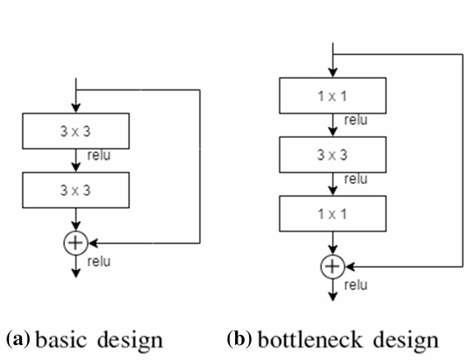
ResNet
2 convolutions both with 3 X 3 filters
3 convolutions with filter sizes 1 X 1, 3 X 3, 1 X 1
1x1 filters for dimension reduction
used to reduce the dimensions during the formation of the network
Basic ResNet blocks+bottleneck blocks to construct better-performing individuals.
Despite different structures, memory and time complexities remain the same

Slide 19
Inception blocks
Inception blocks consist of 1 X 1, 3 X 3, and 5 X 5-sized filters at each layer followed by a max-pooling layer that helps capture different scales.
Before to 3 X 3 and 5 X 5 filters, a 1 X 1 filter is added to reduce the computational complexity.
Different types of inception blocks that chosen randomly during the network construction process.

Slide 20
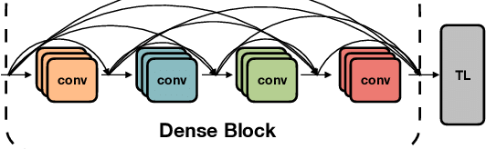
DenseNet
DenseNet is composed of four convolutional layers where each convolutional layer receives inputs from all previous layers and feeds all consequent layers.

Slide 21
Sum up
In the proposed framework, three types of blocks along with pooling layers form the base of the network: ResNet, DenseNet, and Inception.
 | ResNet and DenseNet | Inception blocks
Deals with | Gradient vanishing problem Learning features better | Multi level feature extraction
How | Skip connections | Usage of different sized filters

Slide 22

Automatic Evolutionary CNN (AE-CNN)
Population Initialization: CNN architectures are encoded and evaluated for fitness score.
Training:
Weights Initialization: Xavier method initializes network weights.
Training Process: Stochastic gradient descent optimizes CNN parameters.
Validation:
Model Evaluation: Classification accuracy is assessed on validation data.
Fitness Score: Individual fitness is based on the highest validation accuracy.

Slide 23
Automatic Evolutionary CNN (AE-CNN)
AE-CNN: is a framework that utilizes evolutionary algorithms (or GA) to automatically design CNN architectures for specific tasks.
Initialized population - N individuals constructed randomly
Individual- represents a CNN model
Training
Weights are initialized using the Xavier initialization method.
Training is done by stochastic gradient descent (SGD).
Validation
Fitness evaluation - Individual fitness is based on the highest validation accuracy.

Slide 24

Population initialization
Individual- represents a CNN model:
Four types of units participate in the construction:
ResNet block unit (RBU): ResNet blocks >=1
DenseNet block unit (DBU): DenseNet blocks >=1
Inception block unit (IBU): one Inception block
Pooling layer unit (PU)
Since pooling layers reduce the input size by half, its usage is limit in order not to shrink the input dimensions very fast.

Slide 25
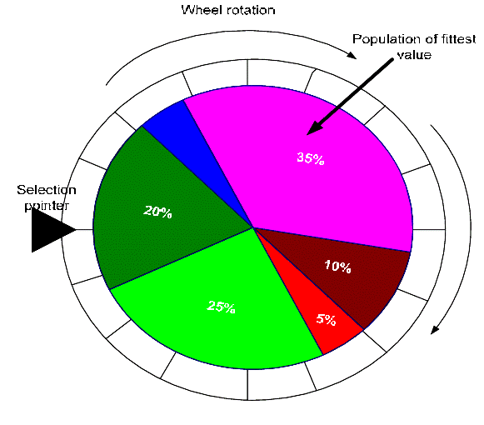
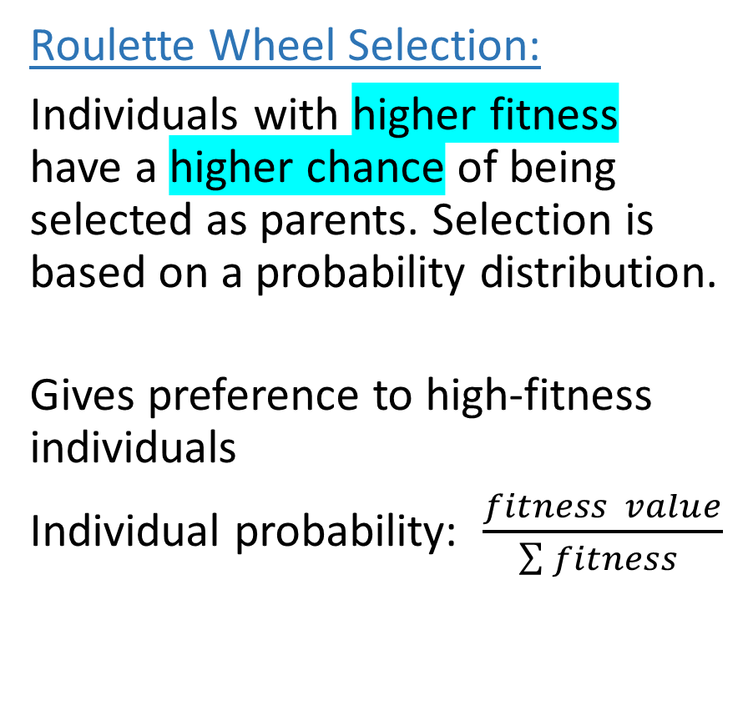
Offspring generation
Binary Tournament Selection:
Two individuals are randomly selected, and the one with the highest fitness becomes the first parent. The second parent is selected similarly.
Ensures population diversity
Crossover Randomly selecting a division point
Roulette Wheel Selection:
Individuals with higher fitness have a higher chance of being selected as parents. Selection is based on a probability distribution.
Gives preference to high-fitness individuals
Individual probability: $\frac{fitness value}{\sum{fitness} }$
Parents
1 | 0 | 1 | 0 | 1 | 0 | 0
0 | 1 | 0 | 1 | 0 | 1 | 1
Offspring
1 | 0 | 0 | 1 | 0 | 1 | 1
0 | 1 | 1 | 0 | 1 | 0 | 0

Slide 26
Experiment Design and Results
Benchmark dataset
Experimental results on CINIC-10
Addition of inception (3a) block
Addition of various inception blocks
Adjusting learning rate to epoch size
Addition of roulette wheel selection method
Addition of basic ResNet block
Experimental results on SVHN
Comparison to other approaches

Slide 27
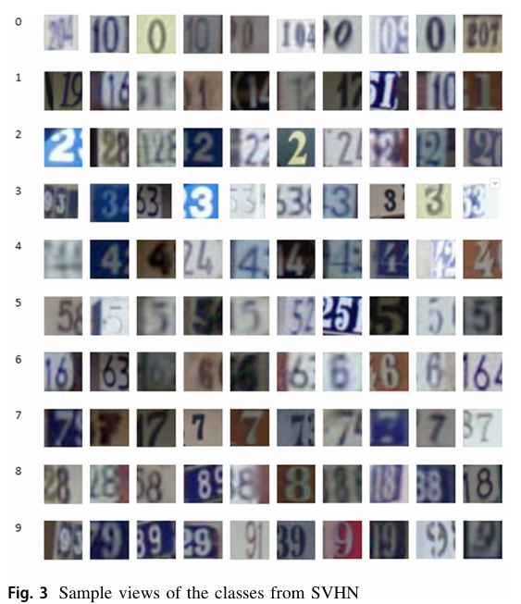
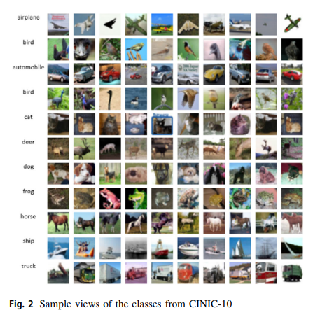
Benchmark dataset
Evaluate and compare the proposed method with AE-CNN on two benchmark datasets: CINIC-10 and SVHN.
 | CINIC-10 Dataset | SVHN Dataset Street View House Numbers
Images | Contains images from both CIFAR-10 and ImageNet datasets. | Real-world digit images cropped from house number pictures. Contains all digits from 0 to 9 Used individually cropped digits for experiments.
Amount | Consists of a total of 270,000 images, with 60,000 from CIFAR-10 and 210,000 from ImageNet | Contains over 600,000 images
Dataset | Dataset is divided equally into train, validation, and test subsets

Slide 28

Parameter Settings
Parameter | Description
Optimizer | SGD (Stochastic Gradient Descent)
Batch Size | 64
Maximum IBUs (Inception Blocks per Unit) | 4
Inception Block Parameters | Aligned with GoogleNet
Learning Rate (LR) | Fixed: 0.1
Selection method | Binary tournament selection
Benchmark | CINIC-10 and SVHN datasets
Evaluation | Average classification accuracy over 20 generations
Comparison | Proposed method vs. AE-CNN
Maximum Epochs | 30 or 50
Experiment Design | Incremental addition of features

Slide 29


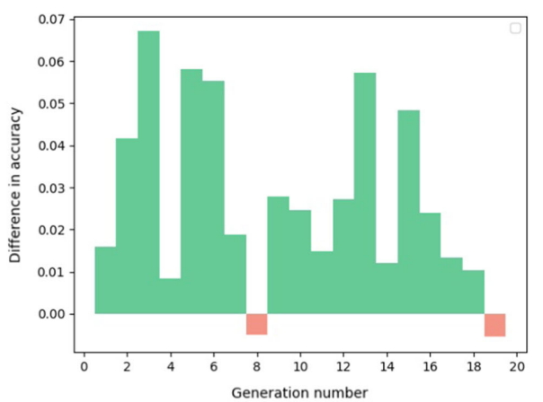
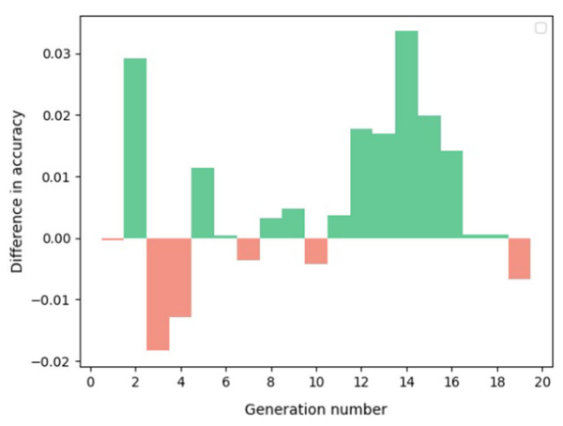
Addition of inception (3a) block
Positive differences = proposed > AE-CNN.
Negative differences = AE-CNN > proposed.
The introduction of inception blocks significantly increases the average accuracy in most generations.
Epoch Size 30
Epoch Size 50
Computation Time:
Epoch size 30: AE-CNN: 5 GPU days | Proposed framework with IBU: 7 GPU days
Epoch size 50: AE-CNN: 7 GPU days | Proposed framework: 10 days
The proposed framework outperformed the previous model with some extra computational complexity.

Slide 30
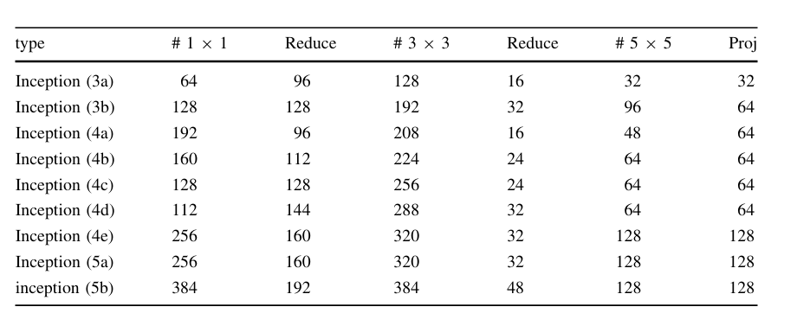
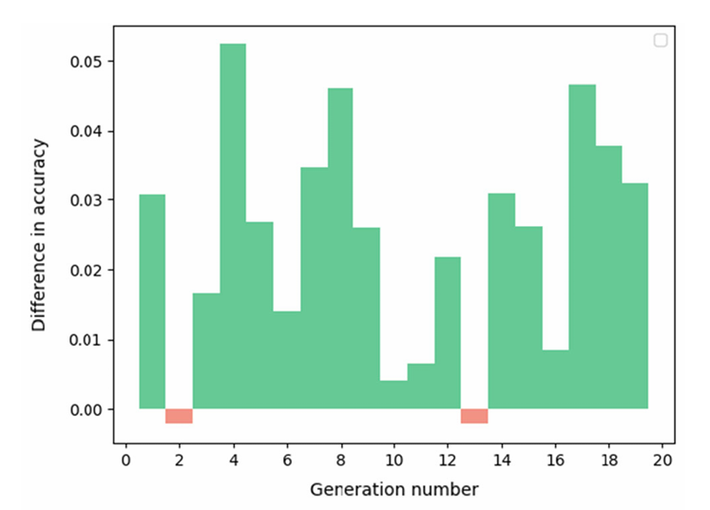
Addition of various inception blocks
Types of inception blocks and parameters
The classification accuracy difference
The results depicted in the graph reveal a substantial positive impact on performance when utilizing different inception block types

Slide 31
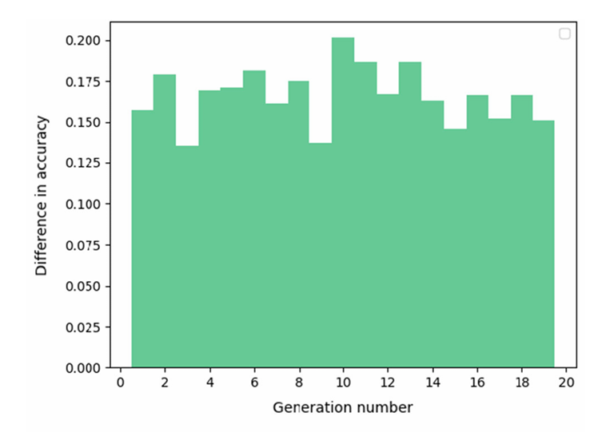
Adjusting dynamic learning rate to epoch size
Experimental Design:
Objective: Evaluate performance with a dynamically adjusted learning rate based on epoch number.
0.1 (Epochs 0-10)
0.01 (Epochs 11-20)
0.001 (Epochs 21+)
The idea is to speed up learning when suitable and to slow down learning near local minima.
The classification accuracy difference obtained in each generation with the adjusted learning rate

Slide 32
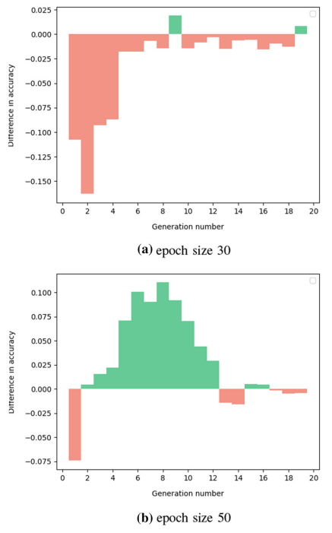
Addition of Roulette Wheel Selection Method
Roulette Wheel Selection Method:
The larger the fitness of an individual is, the more likely that it will be selected.
Experimental Design:
Objective: Evaluate the impact of adding roulette wheel selection to offspring generation comparison with AE-CNN, which used binary tournament selection only.

Slide 33
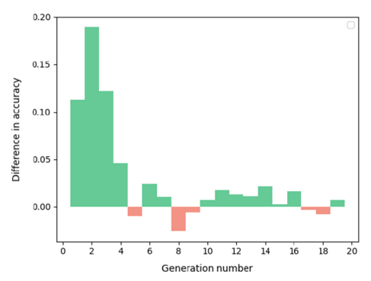
Addition of Basic ResNet Block
Overall comparison with AE-CNN, incorporating all additions, shows consistently better performance of the proposed framework.

Slide 34
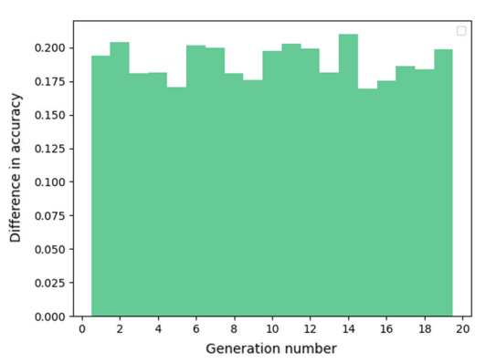
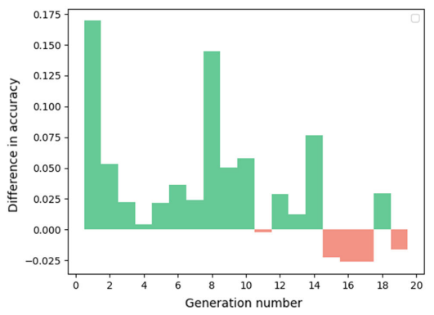
All of the additions comparison
The proposed method was compared with AE-CNN, incorporating all the enhancements introduced earlier.
Fairness consideration: AE-CNN was tested with both fixed and varying learning rates to ensure fairness in the comparison.
AE-CNN with Fixed learning rate
AE-CNN with Dynamic learning rate

Slide 35

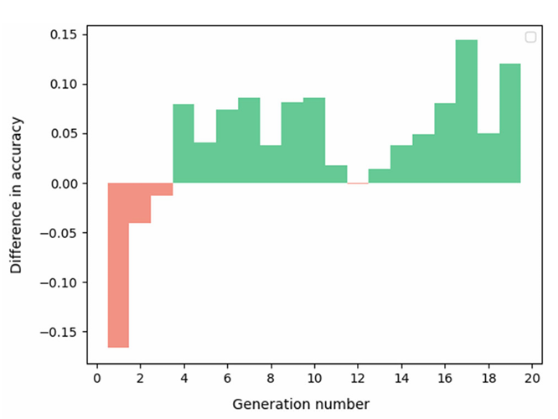
Experimental Results on SVHN Dataset
Evaluation of AE-CNN and Proposed Framework included all proposed additions: inception blocks, dynamic learning rate, roulette wheel selection, and basic ResNet block.
Performance Comparison:
Proposed framework achieved better performance in 16 out of 19 generations compared to AE-CNN.

Slide 36
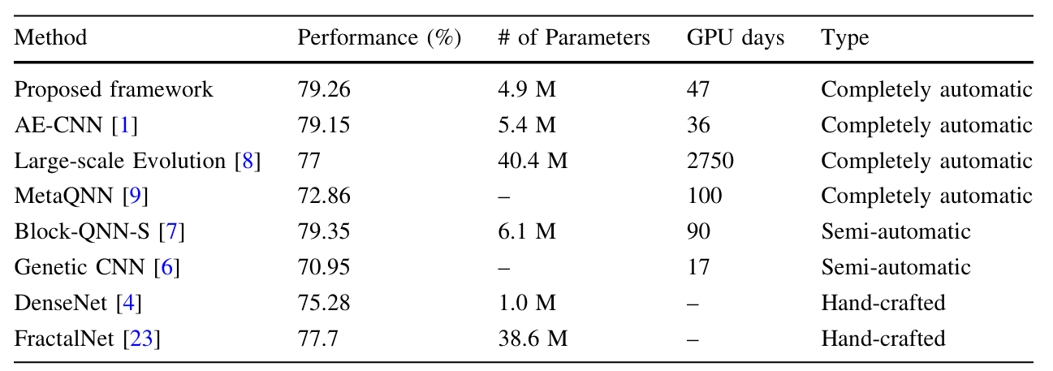
Comparison to Other Approaches
Comparison with leading CNN architecture design algorithms on CIFAR-100
Performance Comparison:
Block-QNN-S slightly outperforms our method but requires domain expertise.
Our framework reduces parameters by nearly 20% compared to Block-QNN-S with minimal accuracy drop.
The construction process is quite general and can be applied to other problems.

Slide 37
Conclusion
The proposed framework improves an existing state-of-the-art algorithm by including important additions.
Inception Blocks: extract features from different scales.
Roulette Wheel Selection: make the over all algorithm more flexible and powerful.
Basic ResNet Blocks: Included to construct better-performing individuals.
Learning rate: dynamic adjustment resulted in improved accuracy.
Future plans: this framework can be used in different domains and applied to other problems, not just to image classification.

Slide 38
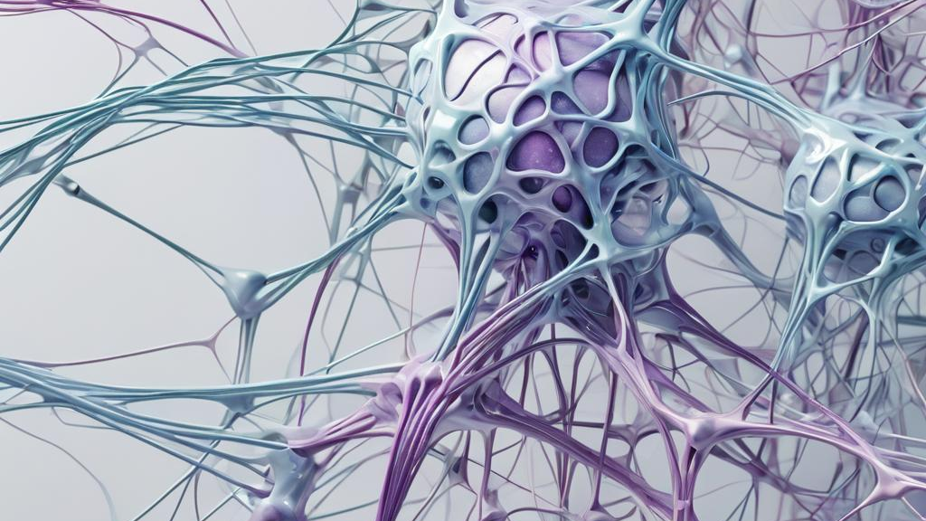
Thank You!

